Slide 1
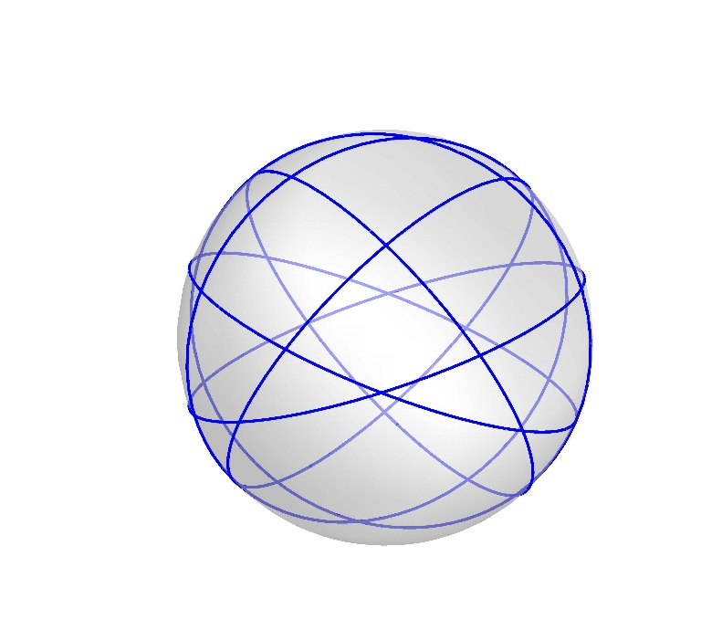
Great Circles Problem
Kha Man
04/07/2015

Slide 2
Outline
Lemma 1
Lemma 2 – The uniqueness of the special graph S_{k}
Lemma 3 – The equivalent graph of S_{k}
Lemma 4 – The properties of S_{k}
Theorem 1 – The chromatic number of S_{k}
The next steps

Slide 3
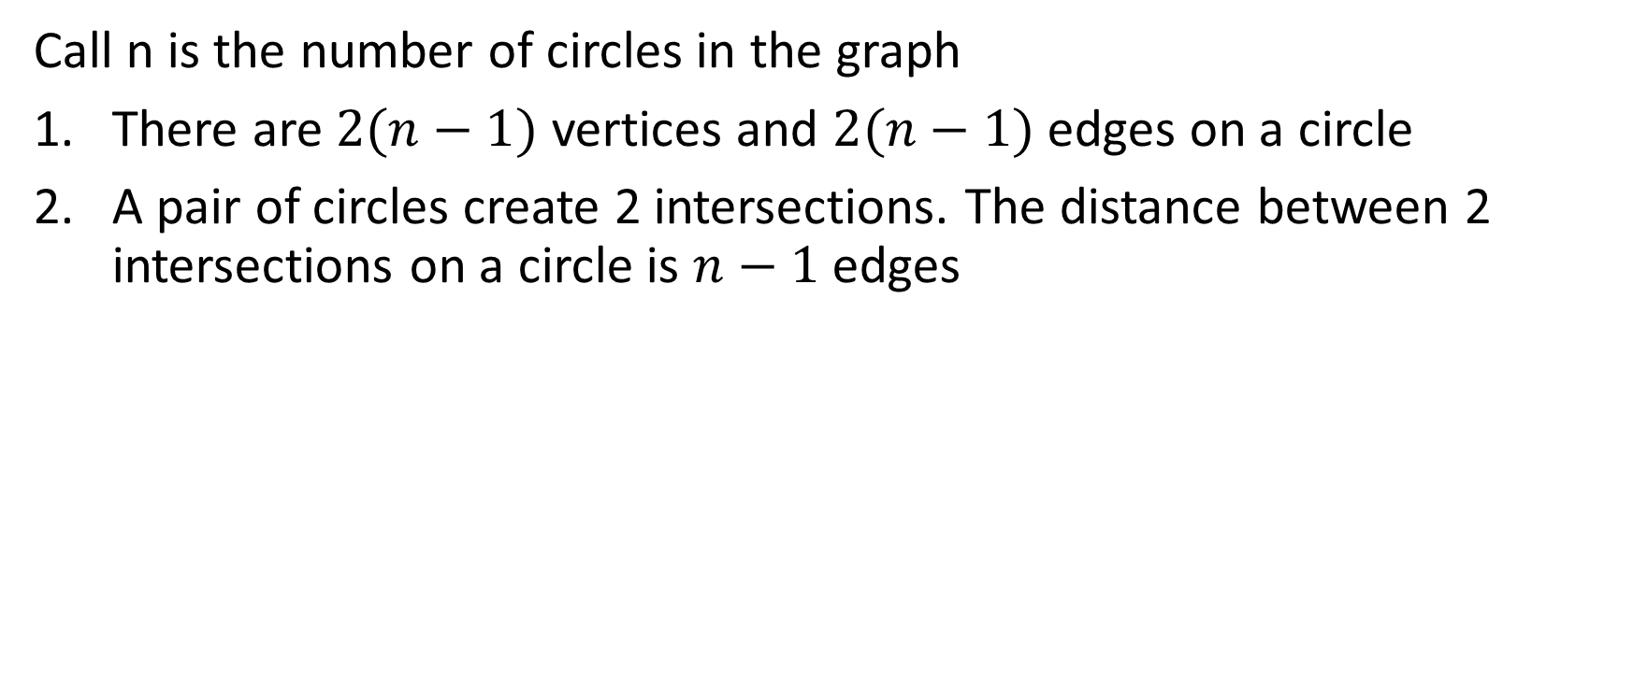
Lemma 1
Call n is the number of circles in the graph
There are $2(n−1)$ vertices and $2(n−1)$ edges on a circle
A pair of circles create 2 intersections. The distance between 2 intersections on a circle is $n−1$ edges

Slide 4
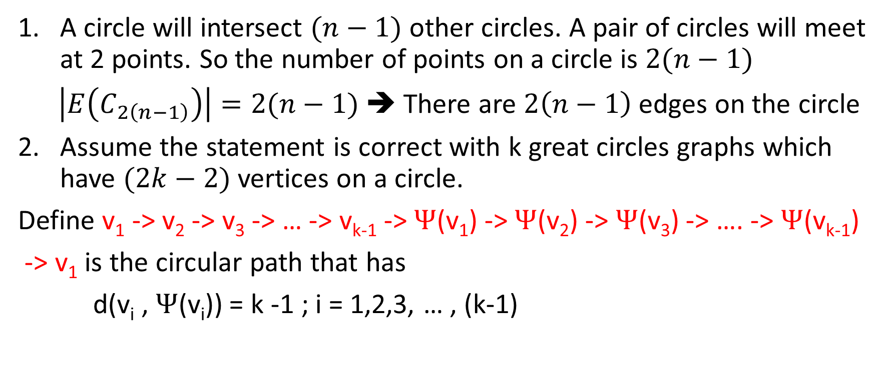
Lemma 1 - Proof
A circle will intersect $(n−1)$ other circles. A pair of circles will meet at 2 points. So the number of points on a circle is $2(n−1)$
$\left|E\left(C_{2\left(n−1\right)}\right)\right|=2(n−1)$ ➔ There are $2\left(n−1\right)$ edges on the circle
Assume the statement is correct with k great circles graphs which have $(2k−2)$ vertices on a circle.
Define v₁ -> v₂ -> v₃ -> … -> v_{k-1} -> $Ψ$(v₁) -> $Ψ$(v₂) -> $Ψ$(v₃) -> …. -> $Ψ$(v_{k-1})
-> v₁ is the circular path that has
d(v_{i} , $Ψ$(v_{i})) = k -1 ; i = 1,2,3, … , (k-1)

Slide 5
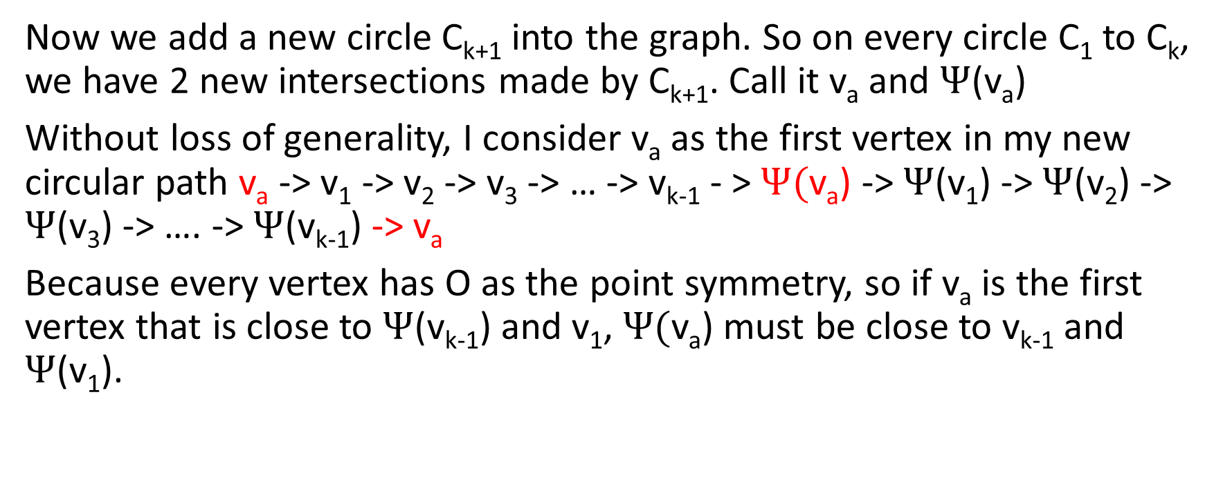
Lemma 1 - Proof
Now we add a new circle C_{k+1} into the graph. So on every circle C₁ to C_{k}, we have 2 new intersections made by C_{k+1}. Call it v_{a} and $Ψ$(v_{a})
Without loss of generality, I consider v_{a} as the first vertex in my new circular path v_{a} -> v₁ -> v₂ -> v₃ -> … -> v_{k-1} - > $Ψ($v_{a}) -> $Ψ$(v₁) -> $Ψ$(v₂) -> $Ψ$(v₃) -> …. -> $Ψ$(v_{k-1}) -> v_{a}
Because every vertex has O as the point symmetry, so if v_{a} is the first vertex that is close to $Ψ$(v_{k-1}) and v₁, $Ψ($v_{a}) must be close to v_{k-1} and $Ψ$(v₁).

Slide 6
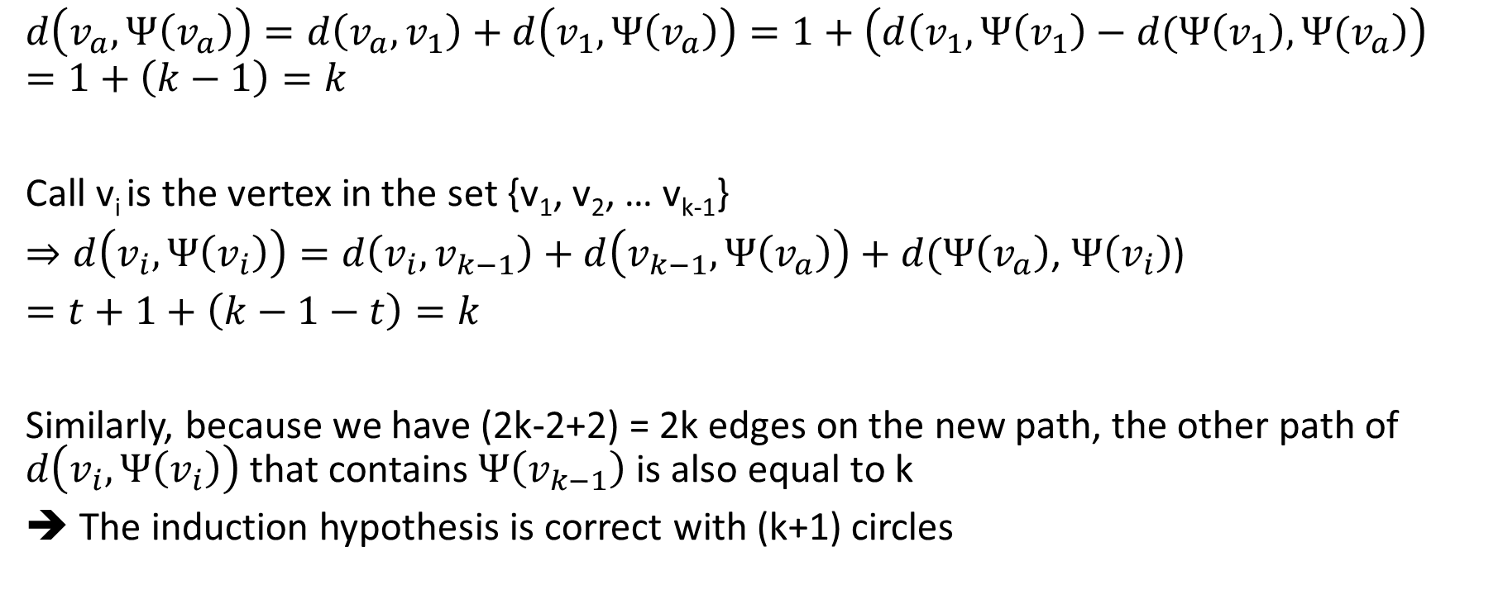
Lemma 1 - Proof
$$d\left(v_{a},Ψ\left(v_{a}\right)\right)=d\left(v_{a}, v_{1}\right)+d\left(v_{1},Ψ\left(v_{a}\right)\right)=1+\left(d\left(v_{1},Ψ\left(v_{1}\right)−d(Ψ\left(v_{1}\right),Ψ(v_{a}\right)\right)$$
$$=1+\left(k−1\right)=k$$
Call v_{i} is the vertex in the set {v₁, v₂, … v_{k-1}}
$⇒d\left(v_{i},Ψ\left(v_{i}\right)\right)=d\left(v_{i}, v_{k−1}\right)+d\left(v_{k−1},Ψ\left(v_{a}\right)\right)+d(Ψ\left(v_{a}\right)$, $Ψ\left(v_{i}\right)$)
$=t+1+\left(k−1−t\right)=k$
Similarly, because we have (2k-2+2) = 2k edges on the new path, the other path of $d\left(v_{i},Ψ\left(v_{i}\right)\right)$ that contains $Ψ\left(v_{k−1}\right)$ is also equal to k
➔ The induction hypothesis is correct with (k+1) circles

Slide 7
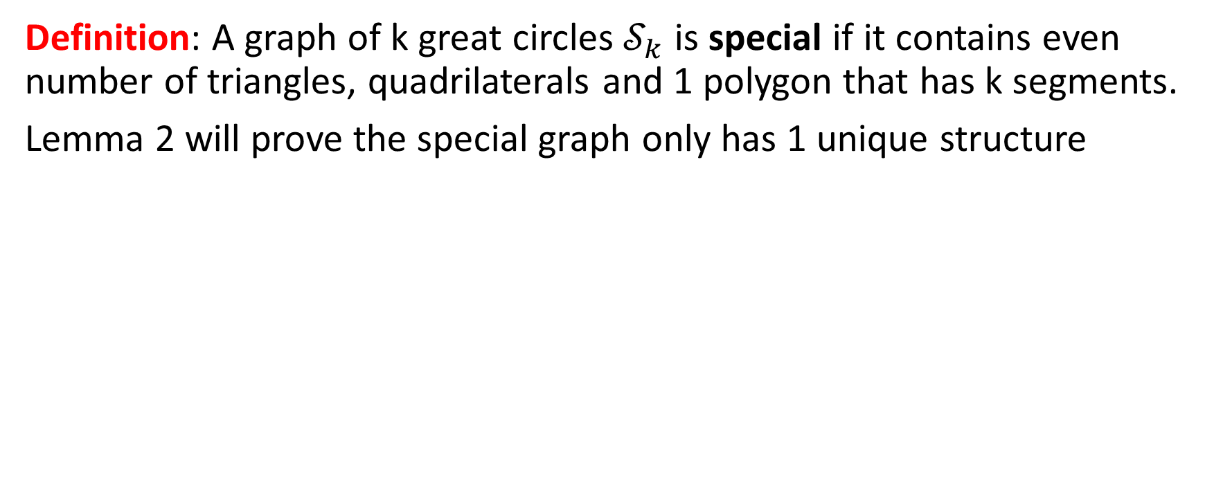
The special graph
Definition: A graph of k great circles $𝒮_{k}$ is special if it contains even number of triangles, quadrilaterals and 1 polygon that has k segments.
Lemma 2 will prove the special graph only has 1 unique structure
6 great circles
7 great circles

Slide 8
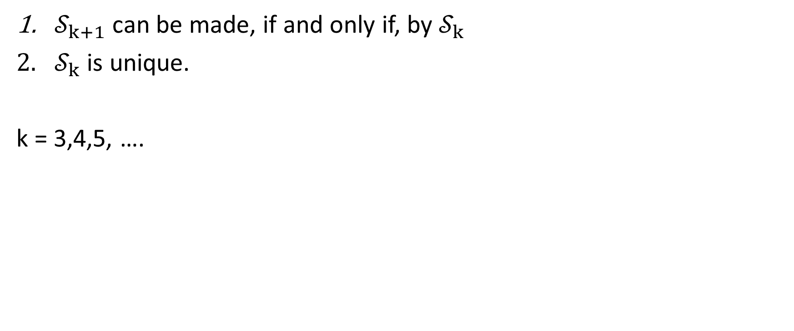
Lemma 2. (The uniqueness of the special graph)
$𝒮_{k+1}$ can be made, if and only if, by $𝒮_{k}$
$𝒮_{k}$ is unique.
k = 3,4,5, ….

Slide 9
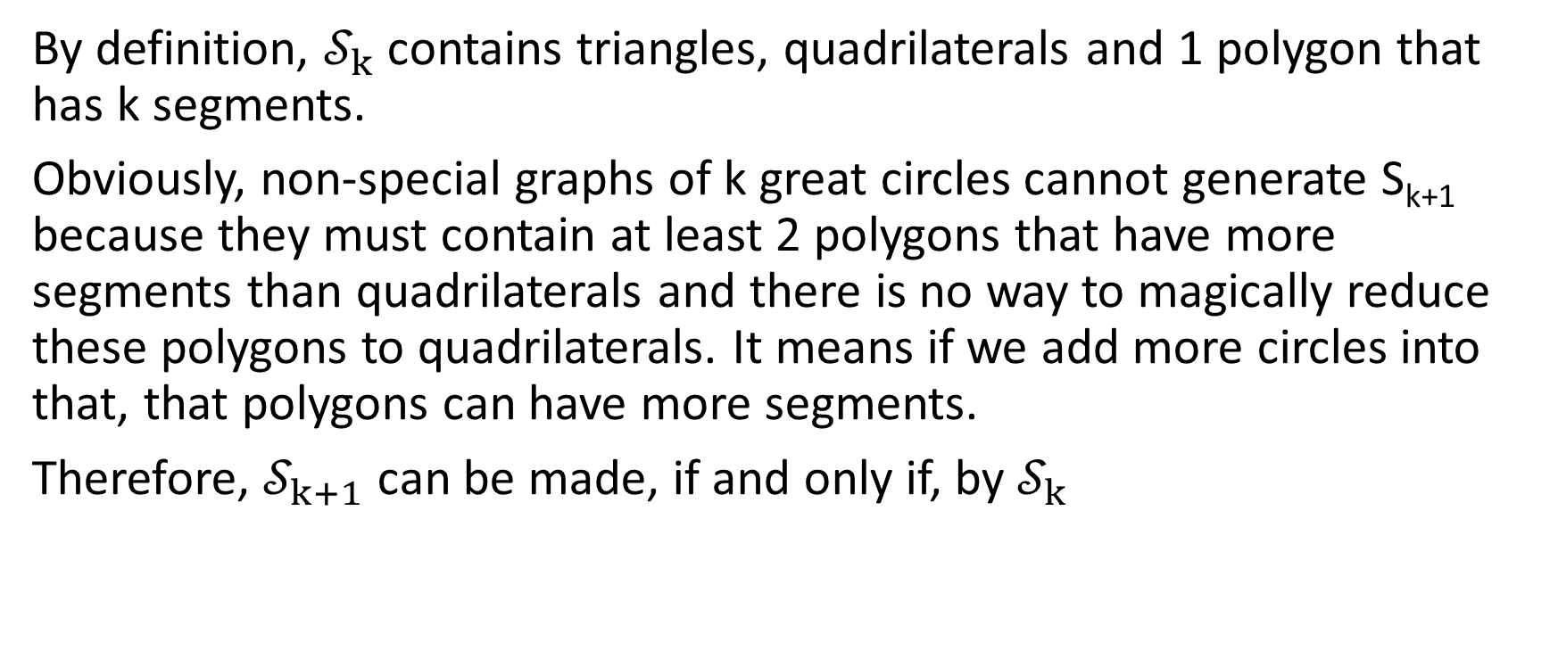
Lemma 2.1 – Proof
By definition, $𝒮_{k}$ contains triangles, quadrilaterals and 1 polygon that has k segments.
Obviously, non-special graphs of k great circles cannot generate S_{k+1} because they must contain at least 2 polygons that have more segments than quadrilaterals and there is no way to magically reduce these polygons to quadrilaterals. It means if we add more circles into that, that polygons can have more segments.
Therefore, $𝒮_{k+1}$ can be made, if and only if, by $𝒮_{k}$

Slide 10
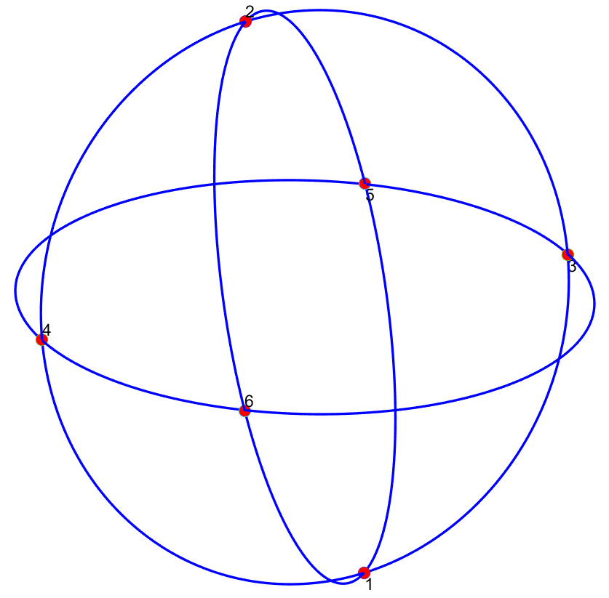
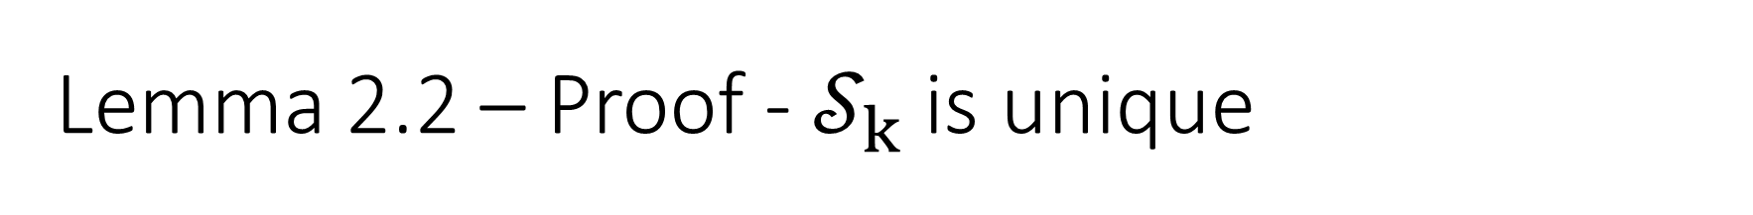
Lemma 2.2 – Proof - $𝒮_{k}$ is unique
3 great circles has 1 non-isomorphic graph and it’s special (We can verify it easily by hand)
3 great circles

Slide 11
Lemma 2.2 – Proof
+ 1 great circle = ???
There are 3 cases happen when the 4th great circle is added:
It cuts arc(1,5), arc(1,3), arc(2,6), arc(2,4), arc(3,6) and arc(4,5)
It cuts arc(1,3), arc(3,5), arc(2,4), arc(4,6), arc(1,6) and arc(2,5)
It cuts arc(1,5), arc(3,5), arc(2,6), arc(4,6), arc(2,6) and arc(1,5)
The outcome of 3 cases is the same as the figure on the right. This graph is special and unique

Slide 12
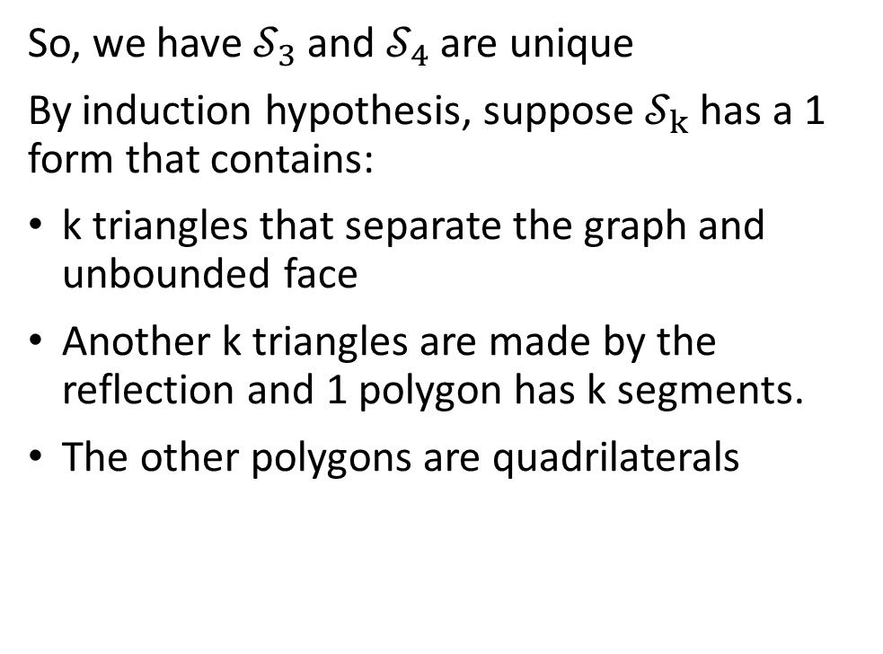
Lemma 2.2 – Proof
So, we have $𝒮_{3}$ and $𝒮_{4}$ are unique
By induction hypothesis, suppose $𝒮_{k}$ has a 1 form that contains:
k triangles that separate the graph and unbounded face
Another k triangles are made by the reflection and 1 polygon has k segments.
The other polygons are quadrilaterals
Notes:
pentagonal

Slide 13
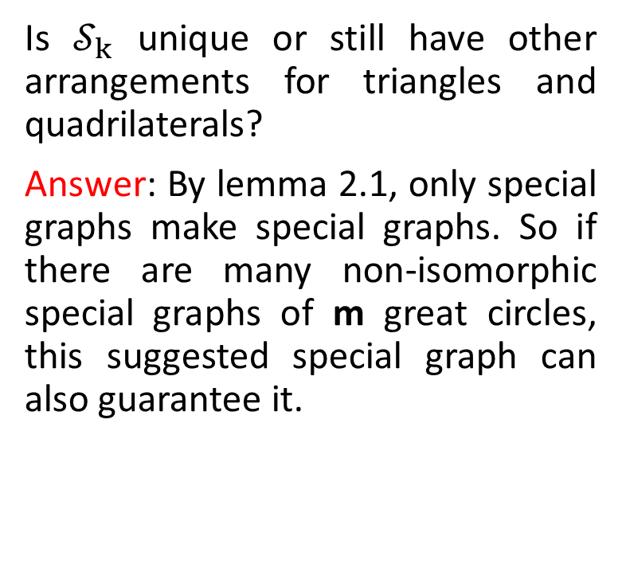
Lemma 2.2 – Proof
Is $𝒮_{k}$ unique or still have other arrangements for triangles and quadrilaterals?
Answer: By lemma 2.1, only special graphs make special graphs. So if there are many non-isomorphic special graphs of m great circles, this suggested special graph can also guarantee it.
Notes:
pentagonal

Slide 14
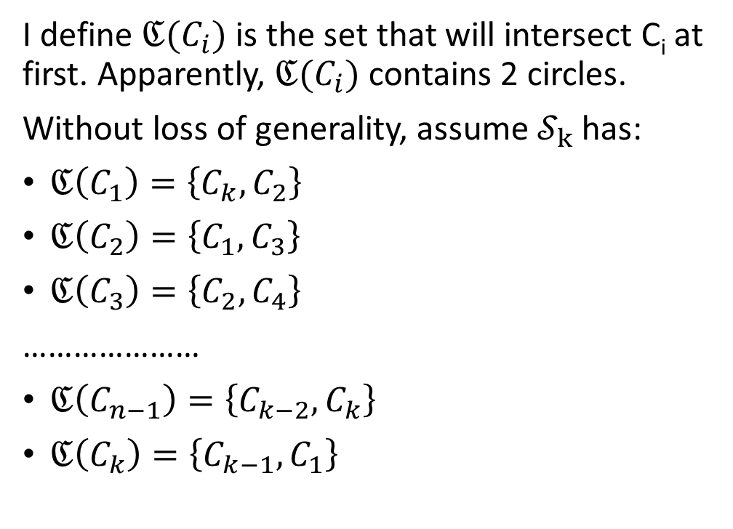
Lemma 2.2 – Proof
I define $ℭ(C_{i})$ is the set that will intersect C_{i} at first. Apparently, $ℭ(C_{i})$ contains 2 circles.
Without loss of generality, assume $𝒮_{k}$ has:
$ℭ\left(C_{1}\right)=\left\{C_{k},C_{2}\right\}$
$ℭ\left(C_{2}\right)=\left\{C_{1},C_{3}\right\}$
$ℭ\left(C_{3}\right)=\left\{C_{2},C_{4}\right\}$
…………………
$ℭ\left(C_{n−1}\right)=\left\{C_{k−2},C_{k}\right\}$
$ℭ\left(C_{k}\right)=\left\{C_{k−1},C_{1}\right\}$
Notes:
pentagonal

Slide 15
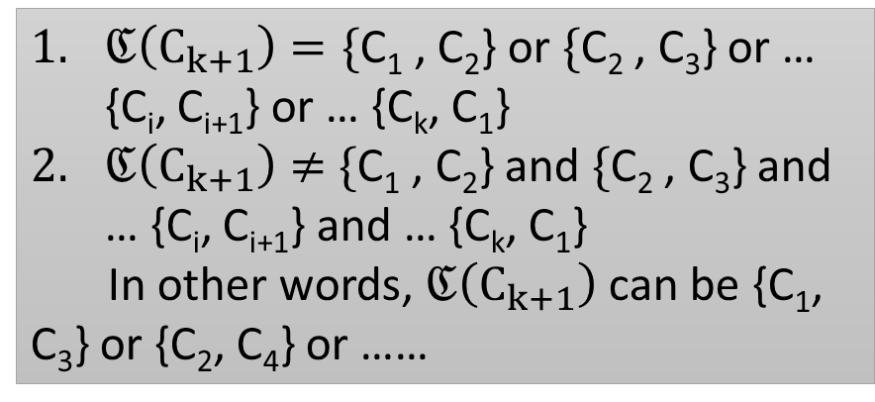
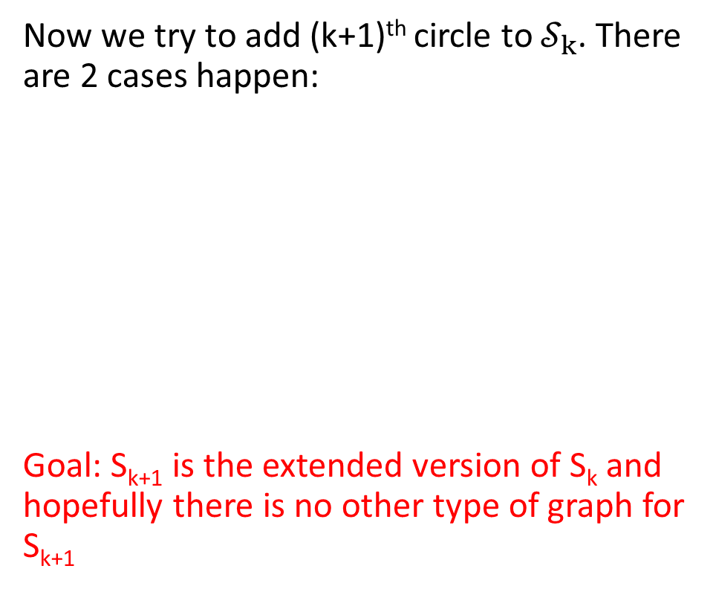
Lemma 2.2 – Proof
Now we try to add (k+1)^{th} circle to $𝒮_{k}$. There are 2 cases happen:
Goal: S_{k+1} is the extended version of S_{k} and hopefully there is no other type of graph for S_{k+1}
$ℭ\left(C_{k+1}\right)=\{$C₁ , C₂} or $\{$C₂ , C₃} or … {C_{i}, C_{i+1}} or … {C_{k}, C₁}
$ℭ\left(C_{k+1}\right)≠$ $\{$C₁ , C₂} and $\{$C₂ , C₃} and … {C_{i}, C_{i+1}} and … {C_{k}, C₁}
In other words, $ℭ\left(C_{k+1}\right)$ can be {C₁, C₃} or {C₂, C₄} or ……
Notes:
pentagonal

Slide 16
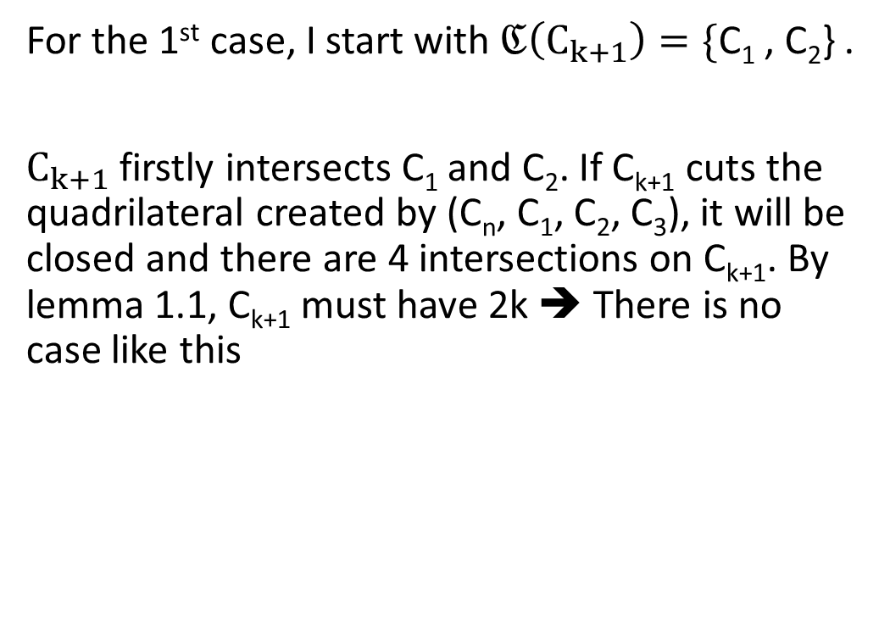
Lemma 2.2 – Proof – 1st case
For the 1st case, I start with $ℭ\left(C_{k+1}\right)=\{$C₁ , C₂} .
$C_{k+1}$ firstly intersects C₁ and C₂. If C_{k+1} cuts the quadrilateral created by (C_{n}, C₁, C₂, C₃), it will be closed and there are 4 intersections on C_{k+1}. By lemma 1.1, C_{k+1} must have 2k ➔ There is no case like this

Slide 17
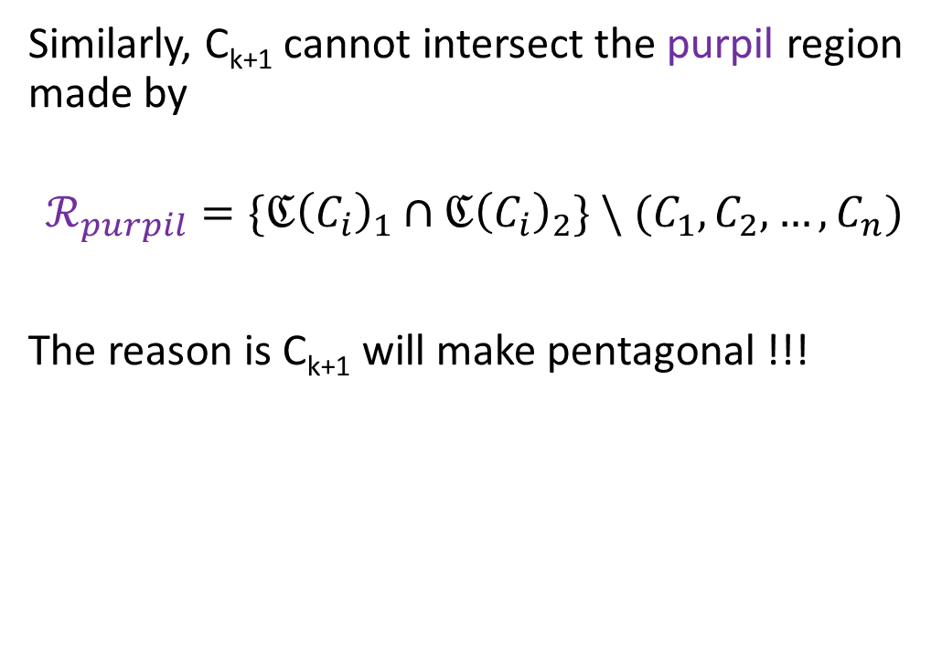
Lemma 2.2 – Proof – 1st case
Similarly, C_{k+1} cannot intersect the purpil region made by
$$ℛ_{purpil}=\{{ℭ\left(C_{i}\right)}_{1}∩{ℭ\left(C_{i}\right)}_{2}\} \backslash (C_{1},C_{2},…,C_{n})$$
The reason is C_{k+1} will make pentagonal !!!

Slide 18
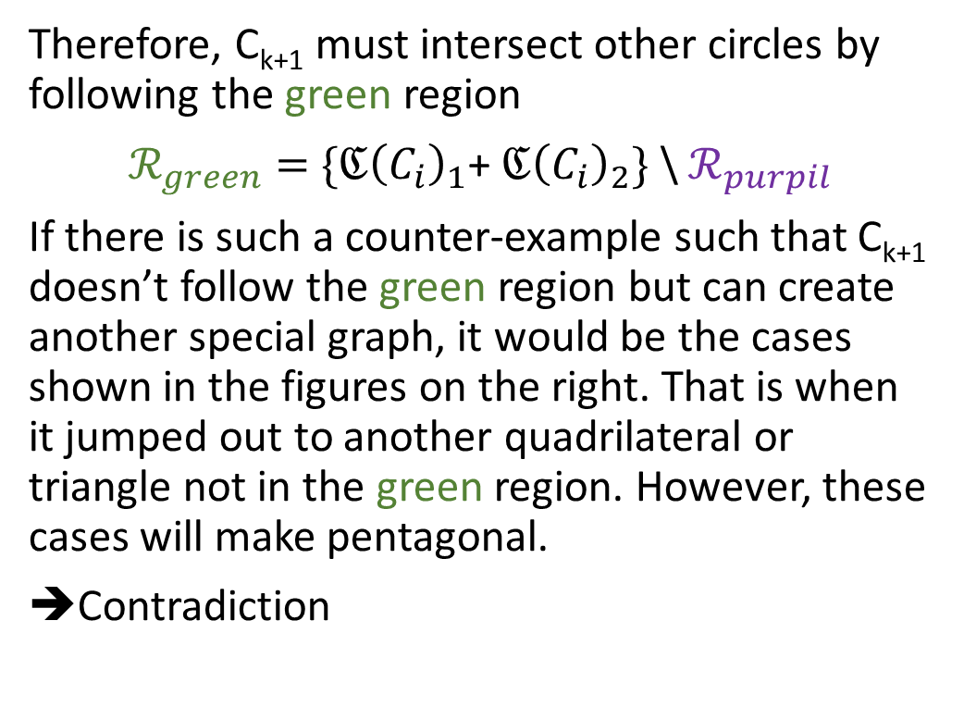
Lemma 2.2 – Proof – 1st case
Therefore, C_{k+1} must intersect other circles by following the green region
$ℛ_{green}=$ ${\{ℭ\left(C_{i}\right)}_{1}$+ ${ℭ\left(C_{i}\right)}_{2}\}$ \ $ℛ_{purpil}$
If there is such a counter-example such that C_{k+1} doesn’t follow the green region but can create another special graph, it would be the cases shown in the figures on the right. That is when it jumped out to another quadrilateral or triangle not in the green region. However, these cases will make pentagonal.
Contradiction

Slide 19
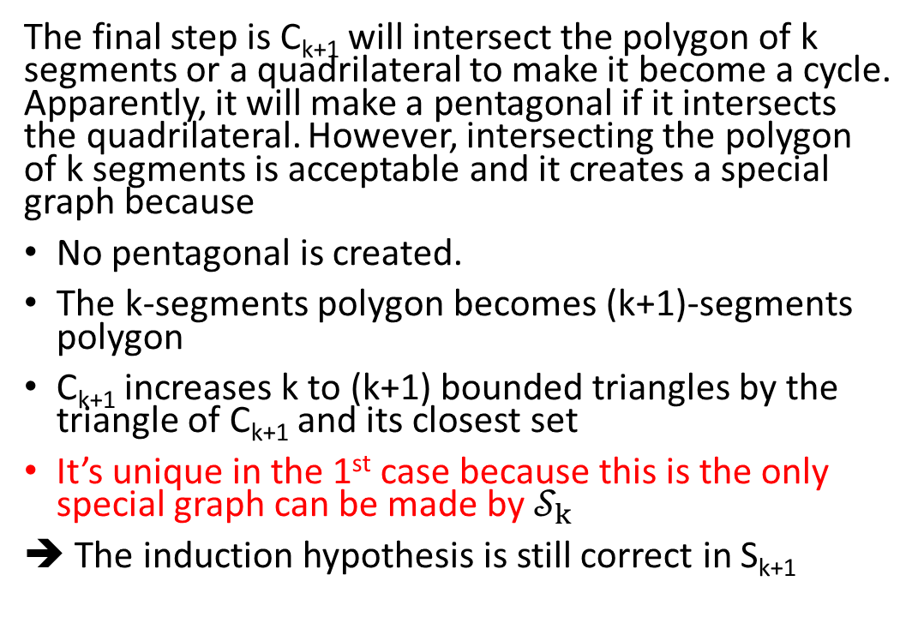
Lemma 2.2 – Proof – 1st case
The final step is C_{k+1} will intersect the polygon of k segments or a quadrilateral to make it become a cycle. Apparently, it will make a pentagonal if it intersects the quadrilateral. However, intersecting the polygon of k segments is acceptable and it creates a special graph because
No pentagonal is created.
The k-segments polygon becomes (k+1)-segments polygon
C_{k+1} increases k to (k+1) bounded triangles by the triangle of C_{k+1} and its closest set
It’s unique in the 1st case because this is the only special graph can be made by $𝒮_{k}$
➔ The induction hypothesis is still correct in S_{k+1}

Slide 20
Lemma 2.2 – Proof – 1st case
Redraw

Slide 21
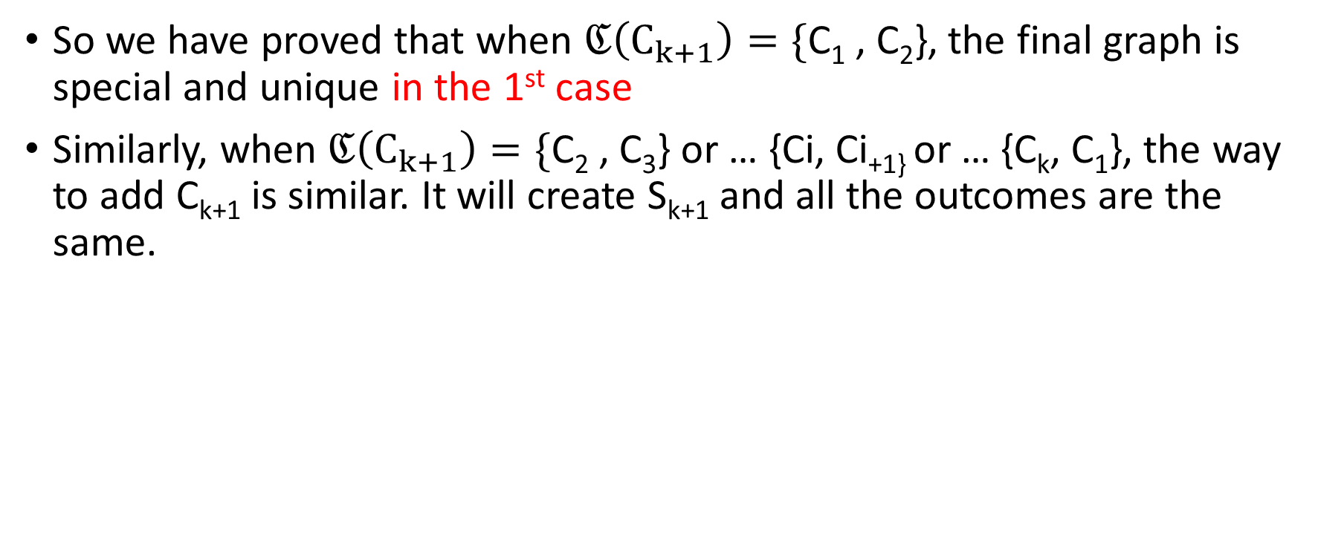
Lemma 2.2 – Proof – 1st case
So we have proved that when $ℭ\left(C_{k+1}\right)=\{$C₁ , C₂}, the final graph is special and unique in the 1st case
Similarly, when $ℭ\left(C_{k+1}\right)=\{\text{C}\text{2}\text{ , }\text{C}\text{3}\text{\} }\text{or}\text{ … \{}\text{Ci}\text{, }\text{Ci}\text{+1\} }\text{or}\text{ … \{}\text{C}\text{k}\text{, }\text{C}\text{1}\text{\}}\text{,}$ the way to add C_{k+1} is similar. It will create S_{k+1} and all the outcomes are the same.

Slide 22
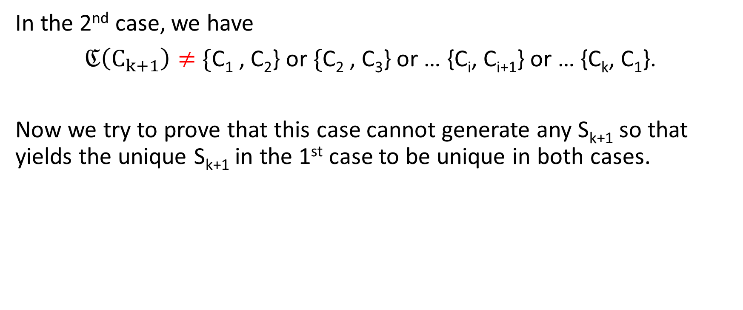
Lemma 2.2 – Proof – 1st case
In the 2nd case, we have
$ℭ\left(C_{k+1}\right)≠$ $\{$C₁ , C₂} or$\{$C₂ , C₃} or … {C_{i}, C_{i+1}} or … {C_{k}, C₁}.
Now we try to prove that this case cannot generate any S_{k+1} so that yields the unique S_{k+1} in the 1st case to be unique in both cases.

Slide 23
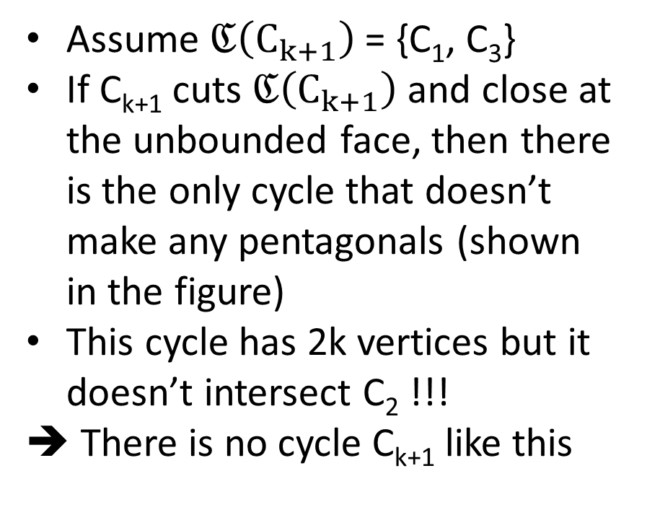
Lemma 2.2 – Proof – 1st case
Assume $ℭ\left(C_{k+1}\right)$ = {C₁, C₃}
If C_{k+1} cuts $ℭ\left(C_{k+1}\right)$ and close at the unbounded face, then there is the only cycle that doesn’t make any pentagonals (shown in the figure)
This cycle has 2k vertices but it doesn’t intersect C₂ !!!
➔ There is no cycle C_{k+1} like this

Slide 24
Lemma 2.2 – Proof – 2nd case
So C_{k+1} will not go to the unbounded face. It means the triangles bound will be the same
Recall that when making intersections, C_{k+1} must split
1 quadrilateral into 2 quadrilaterals
1 triangle to 1 quadrilateral and 1 triangle.
to guarantee the result as a special graph

Slide 25
Lemma 2.2 – Proof – 2nd case
However, the rule above makes C_{k+1} follow only 1 direction that will tend towards the triangles bound.
If C_{k+1} intersects at least 1 triangle at the bound, so the triangles bound will be broken by a new quadrilateral was made
If C_{k+1} tries to not intersect triangle, it must change to follow other ways which then create pentagonals

Slide 26
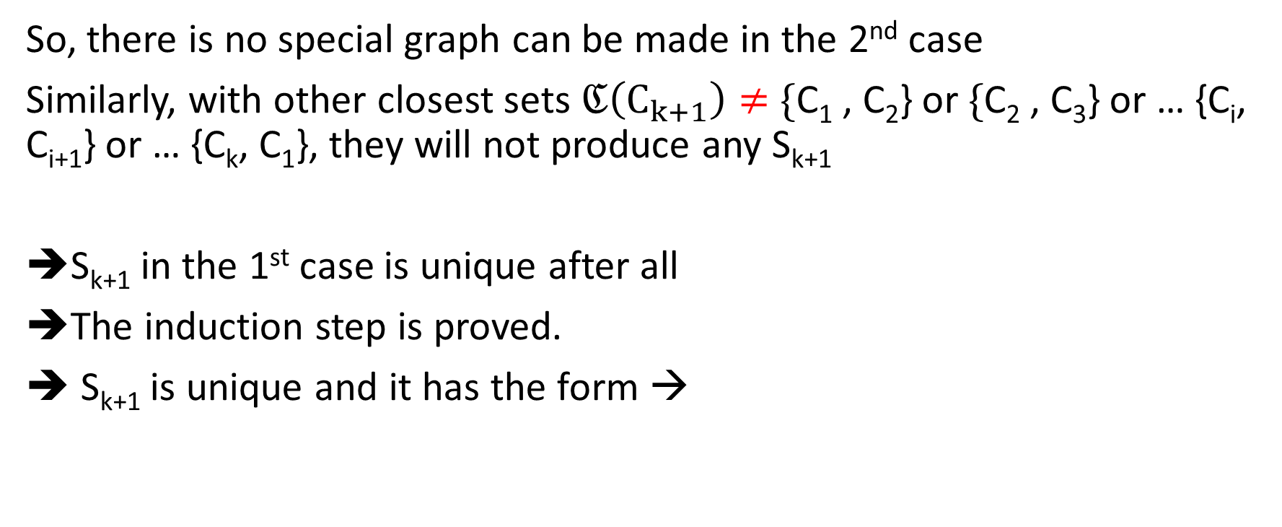
Lemma 2.2 – Proof – 2nd case
So, there is no special graph can be made in the 2nd case
Similarly, with other closest sets $ℭ\left(C_{k+1}\right)≠$ $\{$C₁ , C₂} or$\{$C₂ , C₃} or … {C_{i}, C_{i+1}} or … {C_{k}, C₁}, they will not produce any S_{k+1}
S_{k+1} in the 1st case is unique after all
➔The induction step is proved.
➔ S_{k+1} is unique and it has the form →

Slide 27
S₁₂
S₂₀

Slide 28
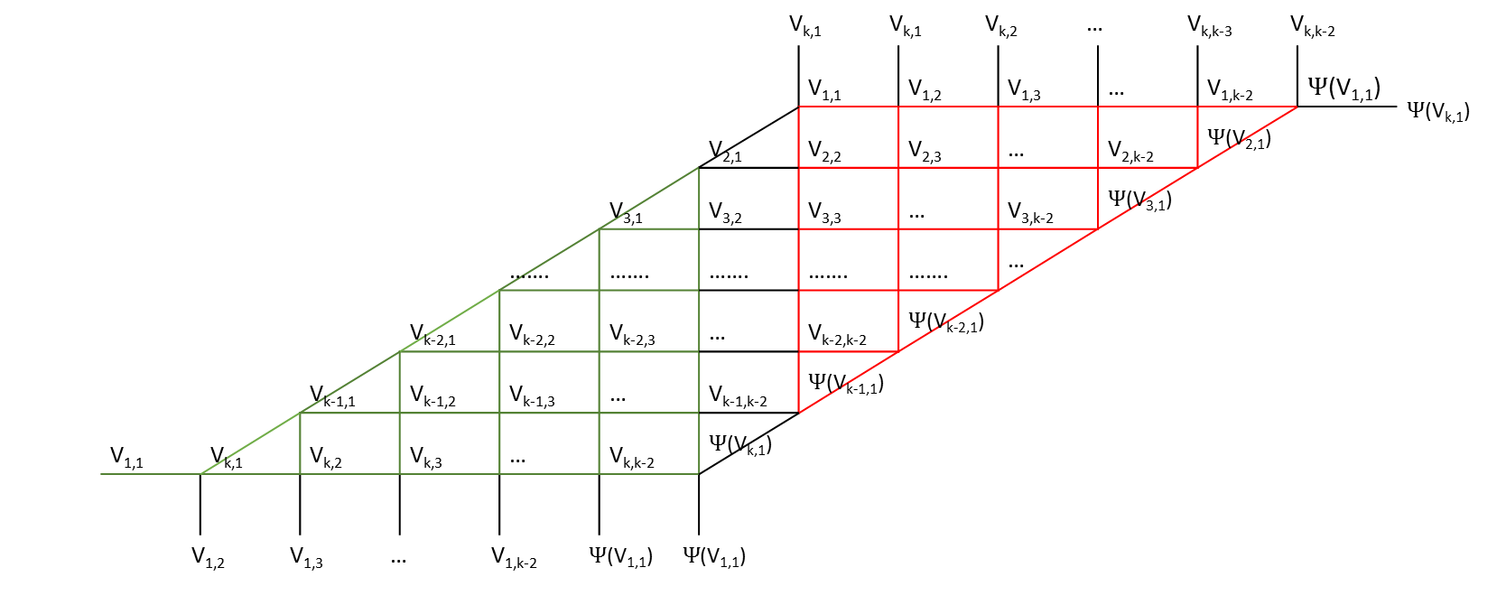
Lemma 3.
S_{k} can be transform into the following equivalent graph:
V_{k,1} V_{k,1} V_{k,2} … V_{k,k-3} V_{k,k-2} |  |  |  |  |  |  |  |  |  |  |  |  |  | $Ψ$(V_{k,1})
 |  |  |  |  |  |  |  | V_{1,1} | V_{1,2} | V_{1,3} | … | V_{1,k-2} | $Ψ$(V_{1,1})
 |  |  |  |  |  |  | V_{2,1} | V_{2,2} | V_{2,3} | … | V_{2,k-2} | $Ψ$(V_{2,1})
 |  |  |  |  |  | V_{3,1} | V_{3,2} | V_{3,3} | … | V_{3,k-2} | $Ψ$(V_{3,1})
 |  |  |  |  | ……. | ……. | ……. | ……. | ……. | …
 |  |  |  | V_{k-2,1} | V_{k-2,2} | V_{k-2,3} | … | V_{k-2,k-2} | $Ψ$(V_{k-2,1})
 |  |  | V_{k-1,1} | V_{k-1,2} | V_{k-1,3} | … | V_{k-1,k-2} | $Ψ$(V_{k-1,1})
 | V_{1,1} | V_{k,1} | V_{k,2} | V_{k,3} | … | V_{k,k-2} | $Ψ$(V_{k,1})
V_{1,2} V_{1,3} … V_{1,k-2} $Ψ$(V_{1,1}) $Ψ$(V_{1,1})

Slide 29
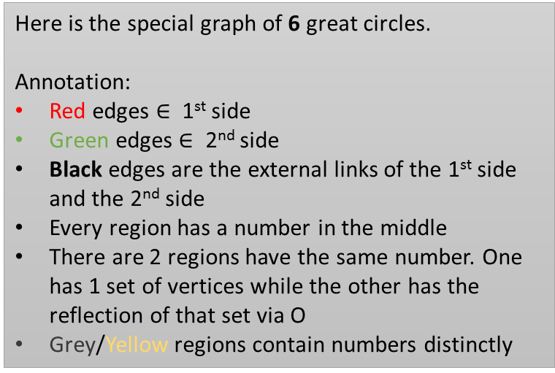
Lemma 3 – Proof – A base case with 6 circles
Here is the special graph of 6 great circles.
Annotation:
Red edges $∈$ 1st side
Green edges $∈$ 2nd side
Black edges are the external links of the 1st side and the 2nd side
Every region has a number in the middle
There are 2 regions have the same number. One has 1 set of vertices while the other has the reflection of that set via O
Grey/Yellow regions contain numbers distinctly

Slide 30
Lemma 3 – Proof – A base case with 6 circles
17 17 16 2 12 |  |  |  |  |  | 14
19 | 13 | 27 | 25 | 6 | 20
19 | 11 | 23 | 21 | 4
5 | 1 | 9 | 7
26 | 15 | 29
28 | 18
 | 14
18 18 15 1 11 |  |  |  |  |  | 13
20 | 14 | 28 | 26 | 5 | 19
20 | 12 | 24 | 22 | 3
6 | 2 | 10 | 8
25 | 16 | 30
27 | 17
 | 13
The number in this grid are vertices

Slide 31
Lemma 3 – Proof – A base case with 6 circles
 | 17 17 16 2 12 |  |  |  |  |  |  |  |  |  | 14
 |  |  |  |  |  | 13 | 27 | 25 | 6 | 20
 |  |  |  |  | 19 | 11 | 23 | 21 | 4
 |  |  |  | 3 | 5 | 1 | 9 | 7
 |  |  | 8 | 22 | 26 | 15 | 29
 |  | 30 | 10 | 24 | 28 | 18
13 | 17 | 16 | 2 | 12 | 14
 | 27 | 25 | 6 | 20 | 20
17 17 16 2 12 |  |  |  |  |  | 14
19 | 13 | 27 | 25 | 6 | 20
19 | 11 | 23 | 21 | 4
5 | 1 | 9 | 7
26 | 15 | 29
28 | 18
 | 14
18 18 15 1 11 |  |  |  |  |  | 13
20 | 14 | 28 | 26 | 5 | 19
20 | 12 | 24 | 22 | 3
6 | 2 | 10 | 8
25 | 16 | 30
27 | 17
 | 13
The number in this grid are vertices

Slide 32

Lemma 3 – Proof – A base case with 7 circles
Here is the special graph of 7 great circles.
Annotation:
Red edges $∈$ 1st side
Green edges $∈$ 2nd side
Black edges are the external links of the 1st side and the 2nd side
Every region has a number in the middle
There are 2 regions have the same number. One has 1 set of vertices while the other has the reflection of that set via O
Grey/Yellow regions contain numbers distinctly

Slide 33
Lemma 3 – Proof – A base case with 7 circles
24 24 25 27 13 3 |  |  |  |  |  |  | 29
12 | 30 | 36 | 40 | 42 | 21 | 11
12 | 4 | 6 | 8 | 10 | 2
22 | 14 | 16 | 18 | 20
41 | 28 | 34 | 38
39 | 26 | 32
35 | 23
 | 29
23 23 26 28 14 4 |  |  |  |  |  |  | 30
11 | 29 | 35 | 39 | 41 | 22 | 12
11 | 3 | 5 | 7 | 9 | 1
21 | 13 | 15 | 17 | 19
42 | 27 | 33 | 37
40 | 25 | 31
36 | 24
 | 30
The number in this grid are vertices

Slide 34
Lemma 3 – Proof – A base case with 7 circles
24 24 25 27 13 3 |  |  |  |  |  |  | 29
12 | 30 | 36 | 40 | 42 | 21 | 11
12 | 4 | 6 | 8 | 10 | 2
22 | 14 | 16 | 18 | 20
41 | 28 | 34 | 38
39 | 26 | 32
35 | 23
 | 29
24 24 25 27 13 3 |  |  |  |  |  |  |  |  |  |  |  |  |  | 29
 |  |  |  |  |  |  |  | 30 | 36 | 40 | 42 | 21 | 11
 |  |  |  |  |  |  | 12 | 4 | 6 | 8 | 10 | 2
 |  |  |  |  |  | 1 | 22 | 14 | 16 | 18 | 20
 |  |  |  |  | 19 | 9 | 41 | 28 | 34 | 38
 |  |  |  | 37 | 17 | 7 | 39 | 26 | 32
 |  |  | 31 | 33 | 15 | 5 | 35 | 23
 | 30 | 24 | 25 | 27 | 13 | 3 | 29
36 40 42 21 11 11
23 23 26 28 14 4 |  |  |  |  |  |  | 30
11 | 29 | 35 | 39 | 41 | 22 | 12
11 | 3 | 5 | 7 | 9 | 1
21 | 13 | 15 | 17 | 19
42 | 27 | 33 | 37
40 | 25 | 31
36 | 24
 | 30
The number in this grid are vertices

Slide 35
Lemma 3
Call
V_{i,1} are the vertices made by C_{i} and C_{i+1} on the unbounded cycle.
V_{i,1} , V_{i,2} , V_{i,3} , … V_{i,2k-2} are the vertices on the circle C_{i} in the order that (V_{i,1}, V_{i,2}, V_{i+1,1} ) is a triangle

Slide 36
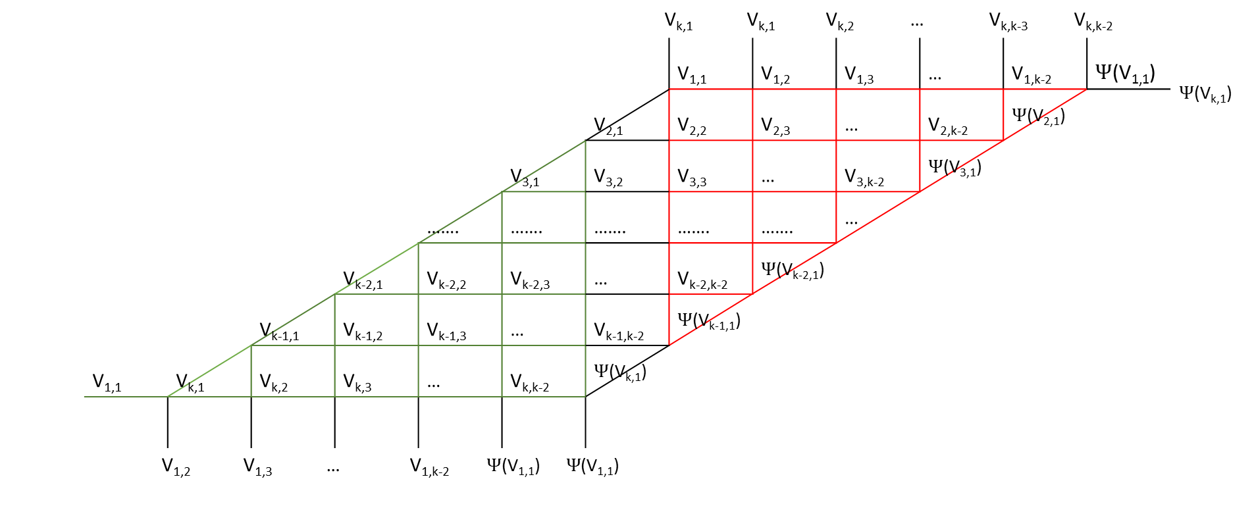
V_{k,1} V_{k,1} V_{k,2} … V_{k,k-3} V_{k,k-2} |  |  |  |  |  |  |  |  |  |  |  |  |  | $Ψ$(V_{k,1})
 |  |  |  |  |  |  |  | V_{1,1} | V_{1,2} | V_{1,3} | … | V_{1,k-2} | $Ψ$(V_{1,1})
 |  |  |  |  |  |  | V_{2,1} | V_{2,2} | V_{2,3} | … | V_{2,k-2} | $Ψ$(V_{2,1})
 |  |  |  |  |  | V_{3,1} | V_{3,2} | V_{3,3} | … | V_{3,k-2} | $Ψ$(V_{3,1})
 |  |  |  |  | ……. | ……. | ……. | ……. | ……. | …
 |  |  |  | V_{k-2,1} | V_{k-2,2} | V_{k-2,3} | … | V_{k-2,k-2} | $Ψ$(V_{k-2,1})
 |  |  | V_{k-1,1} | V_{k-1,2} | V_{k-1,3} | … | V_{k-1,k-2} | $Ψ$(V_{k-1,1})
 | V_{1,1} | V_{k,1} | V_{k,2} | V_{k,3} | … | V_{k,k-2} | $Ψ$(V_{k,1})
V_{1,2} V_{1,3} … V_{1,k-2} $Ψ$(V_{1,1}) $Ψ$(V_{1,1})

Slide 37
Lemma 4. The properties of S_{k}
There are 2k triangles, (k-1)*(k-3) quadrilaterals and 1 polygon has k segments.
Proof: By Lemma 2.2 and Lemma 3, we can easily count this

Slide 38
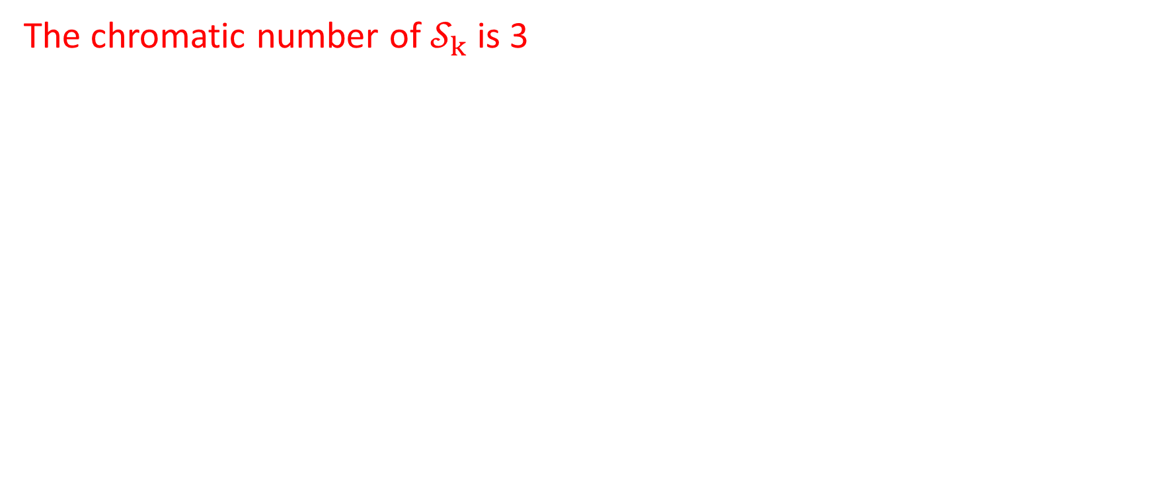
Theorem 1
The chromatic number of $𝒮_{k}$ is 3

Slide 39
Theorem 1 – Proof
By Lemma 2.2, S_{k} is unique
By Lemma 3, S_{k} can be transformed into an equivalent parallelogram
The proof to prove the equivalent parallelogram is 3-colorable is in the presentation in 01-25-2015

Slide 40
The next steps
Other non-special graphs are made by special graphs. They will all have form by S_{k} adding m new great circles that only make vertices inside of S_{k}
The non-special graphs can be counted because when adding a new great circle into S_{k}, there are not infinite ways to do that
Since we have S_{k} is 3-colorable, adding more great circles might be solved by Kempe switch

